Slide 1
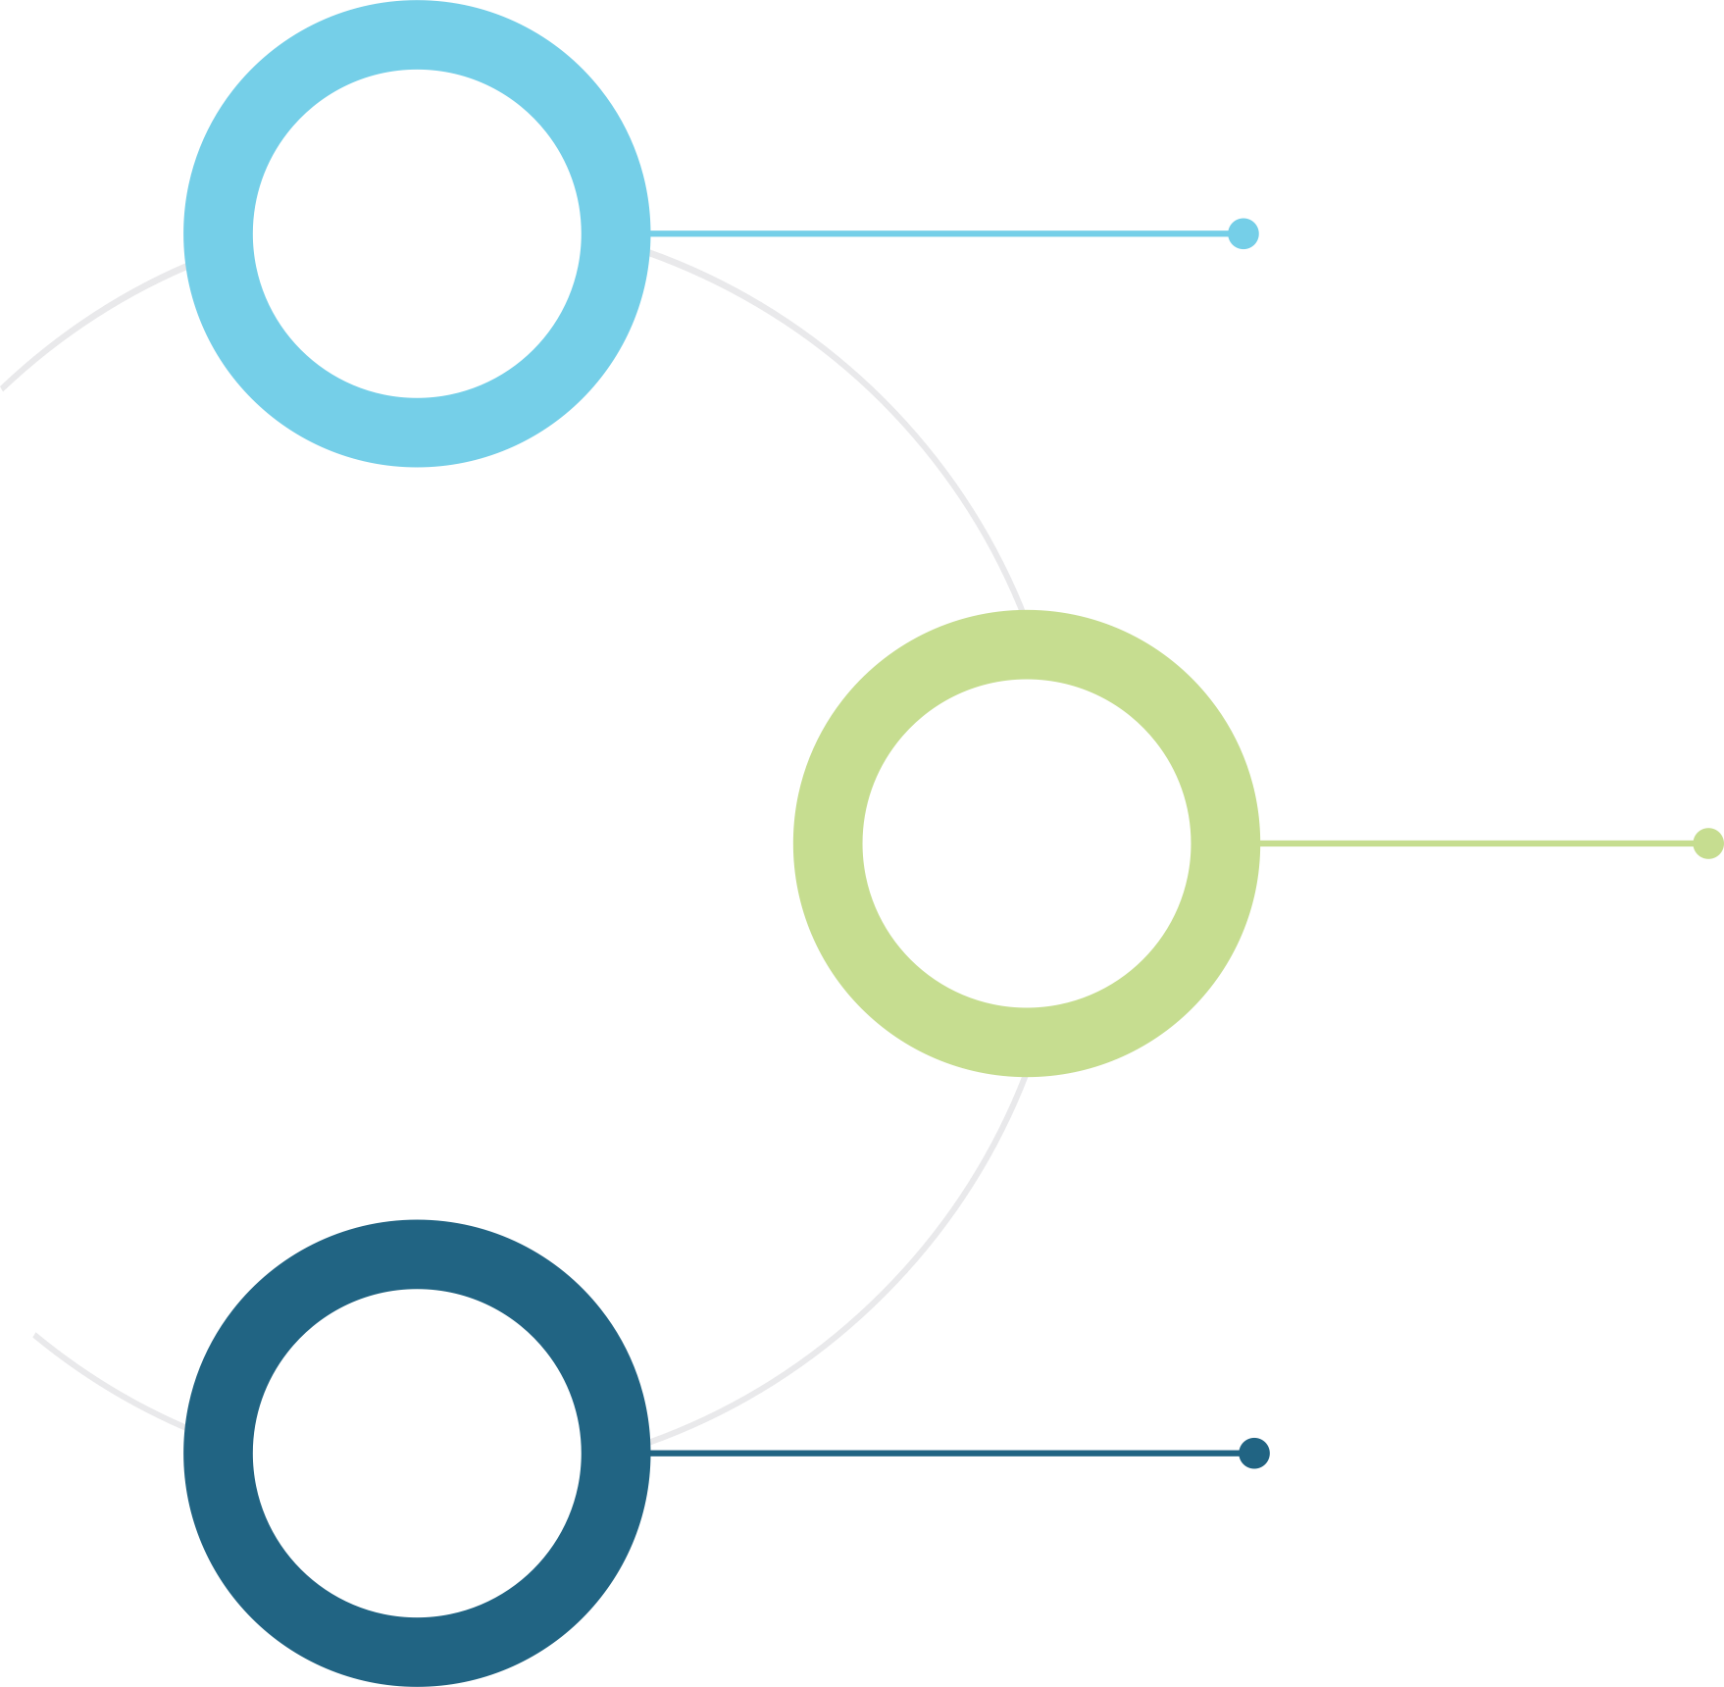



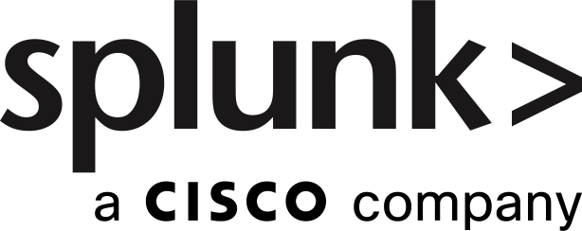









Power of Cisco + Splunk
Network Assurance – See What Matters. Fix What Breaks
August Schell helps organizations unlock the full value of Cisco and Splunk by turning network data into real operational insight. By integrating Cisco infrastructure with Splunk analytics and automation, ASE enables customers to quickly detect issues, understand service impact, and resolve problems before they affect mission operations.
Bringing Cisco and Splunk Together
ASE helps organizations connect their Cisco network infrastructure with Splunk’s operational intelligence platform, creating a unified view of network health, service performance, and security activity.
Unified visibility across network, applications, and infrastructure
Operational dashboards for NetOps, SecOps, and leadership teams
Faster detection of service disruptions and performance issues
Cisco Ecosystem
  Provides end-to-end visibility into network and internet performance.
  Analyzes machine data for real-time operational and security insights.
SECURE NETWORK ANALYTICS
  Observability of network traffic insights beyond NetFlow data
  Delivers secure networking infrastructure and foundational telemetry.
  Monitors application performance and user experience.
Turning Network Data into Action
ASE doesn’t just deploy technology—we help operationalize it.
Transform Cisco telemetry into clear operational insights
Enable real-time service visibility across critical systems
Automate investigation and response to reduce operational burden

Slide 2











Power of Cisco + Splunk
Network Assurance – See What Matters. Fix What Breaks
How ASE Delivers Value
ASE combines deep expertise in Cisco networking and Splunk analytics to help customers quickly realize value.
Integrates Cisco infrastructure data into Splunk operational dashboards
Implements automation and response workflows
Designs service health monitoring
aligned to mission outcomes
Provides engineering support to ensure long-term success
Cisco Infrastructure Telemetry
Unified Splunk Dashboards
IT Service Intelligence
Root Cause Analysis
KPPI “Glass Table” Dashboards
Automoated remediation
Secure Network Analytics
AppDynamics
Cisco Spaces
NetOps
SecOps
NOC
SOC
Customer Outcomes
Faster detection of network and service issues
Unified operational visibility across the enterprise
Reduced time to resolve outages and performance problems
Greater value from existing Cisco and Splunk investments

